Slide 1



Slide 2

^{The language we use:} 10 (8) minutes on introspection, feedback and self-awareness
Chris Unwin

Slide 3


Slide 4

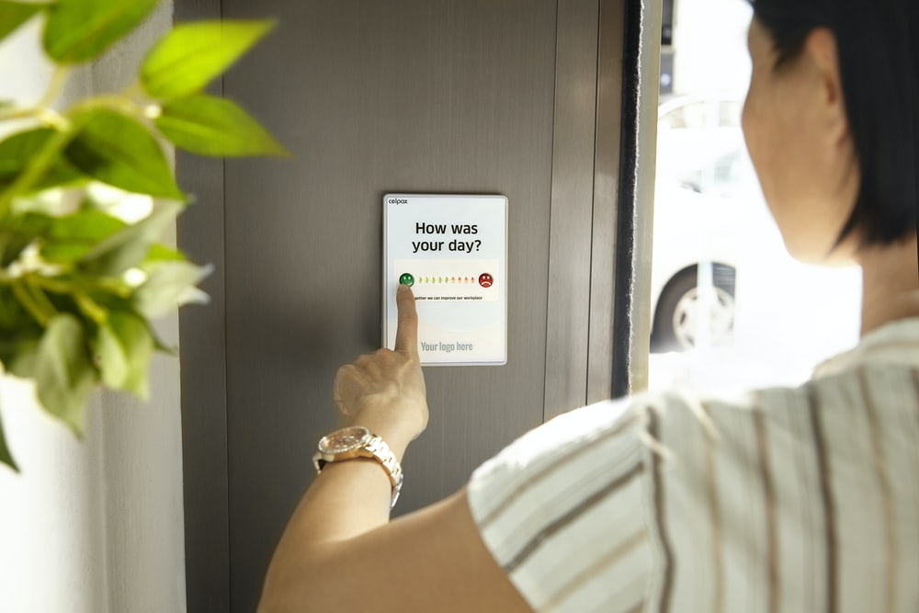

Our Thoughts
Notes:
Images:
https://images.unsplash.com/photo-1508591360875-10163ed98c8e?ixlib=rb-1.2.1&ixid=eyJhcHBfaWQiOjEyMDd9&auto=format&fit=crop&w=675&q=80
https://images.unsplash.com/photo-1589187775328-882e91b3db4f?ixlib=rb-1.2.1&ixid=eyJhcHBfaWQiOjEyMDd9&auto=format&fit=crop&w=1350&q=80
https://images.unsplash.com/photo-1446511437394-36cdff3ae1b3?ixlib=rb-1.2.1&ixid=eyJhcHBfaWQiOjEyMDd9&auto=format&fit=crop&w=1350&q=80

Slide 5

“Good”
Notes:
Images:
https://images.unsplash.com/photo-1489710437720-ebb67ec84dd2?ixlib=rb-1.2.1&ixid=eyJhcHBfaWQiOjEyMDd9&auto=format&fit=crop&w=1350&q=80

Slide 6
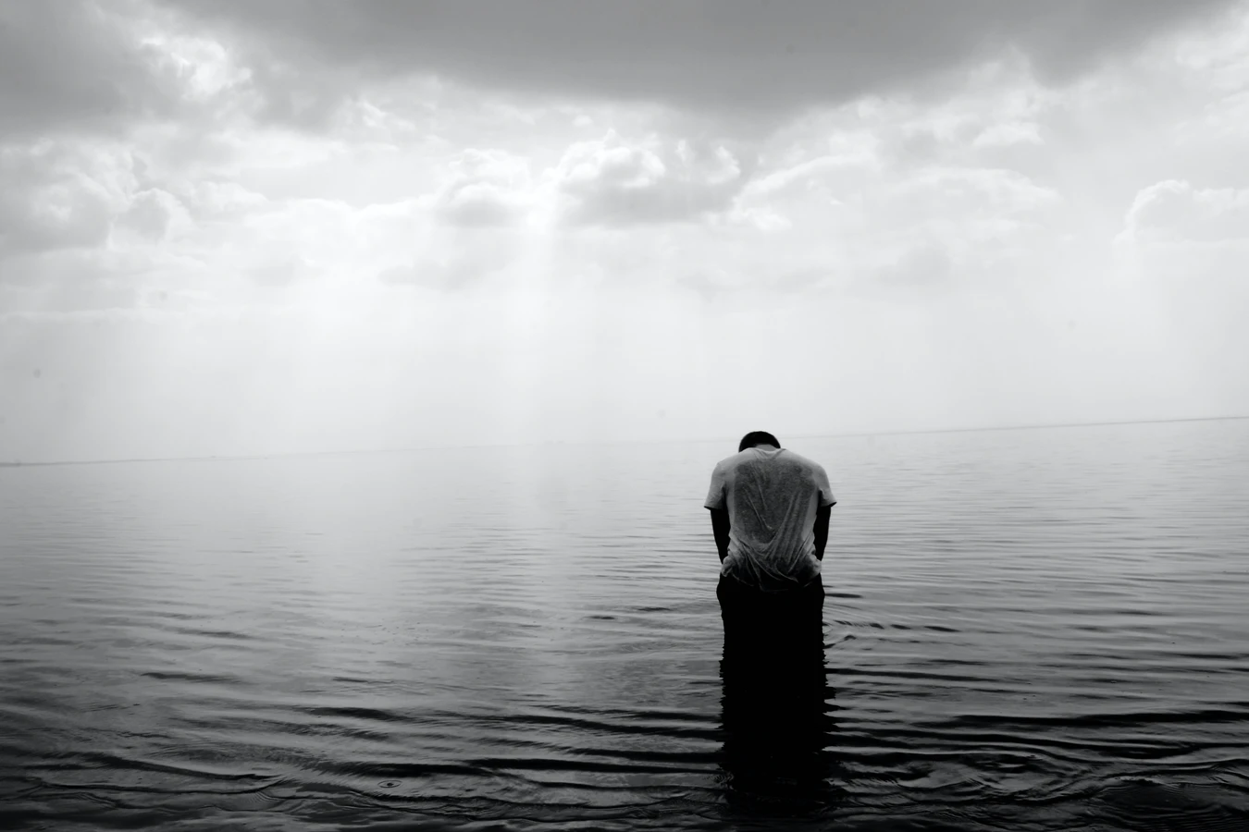
“Bad”
Notes:
Images:
https://images.unsplash.com/reserve/dPfjQTyJSJ2LpM7D9Yr0_Photo%2015-02-2014.jpg?ixlib=rb-1.2.1&ixid=eyJhcHBfaWQiOjEyMDd9&auto=format&fit=crop&w=1350&q=80

Slide 7
“Meh”

Slide 8
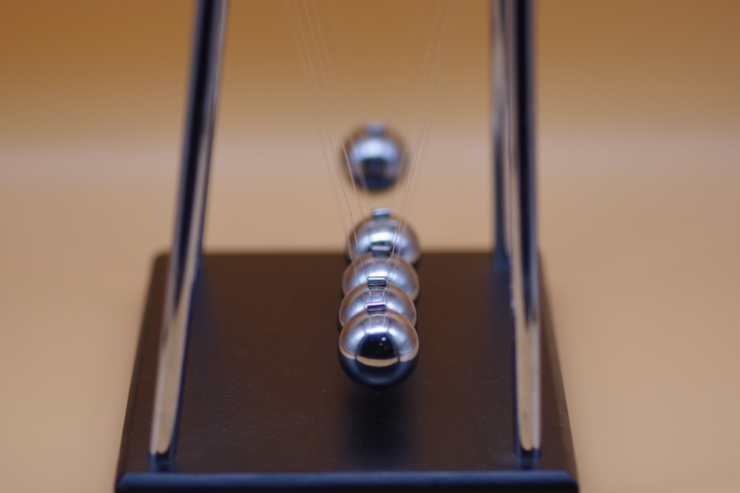
Our thoughts have a profound impact on who we are.
Notes:
Image: https://images.unsplash.com/photo-1588720516255-fc99581c9716?ixlib=rb-1.2.1&ixid=eyJhcHBfaWQiOjEyMDd9&auto=format&fit=crop&w=1350&q=80

Slide 9

#1: Introspection
You are not the product of your thoughts.
Your thoughts are the product of your experiences.
You choose how to experience those thoughts and emotions.
Notes:
Image: https://images.unsplash.com/photo-1531956759688-e71cc2586e34?ixlib=rb-1.2.1&ixid=eyJhcHBfaWQiOjEyMDd9&auto=format&fit=crop&w=634&q=80
Introspection: the process of observing the operations of one’s own mind

Slide 10




Observe.
Acknowledge.
Adjust.
Notes:
Image: https://images.unsplash.com/photo-1543210089-238ae1f26b32?ixlib=rb-1.2.1&ixid=eyJhcHBfaWQiOjEyMDd9&auto=format&fit=crop&w=634&q=80

Slide 11

#2: Self Awareness
Self awareness is not just knowing where you are and what you’re doing
Self awareness is about Monitoring
Understanding our stress, worries, emotions and beliefs
Notes:
Image: https://images.unsplash.com/photo-1531956759688-e71cc2586e34?ixlib=rb-1.2.1&ixid=eyJhcHBfaWQiOjEyMDd9&auto=format&fit=crop&w=634&q=80

Slide 12

Embrace Vulnerability
and Honesty.
Notes:
Image: https://images.unsplash.com/photo-1571266882932-33f7c046a0c9?ixlib=rb-1.2.1&ixid=eyJhcHBfaWQiOjEyMDd9&auto=format&fit=crop&w=634&q=80
Don’t let shame control you.

Slide 13
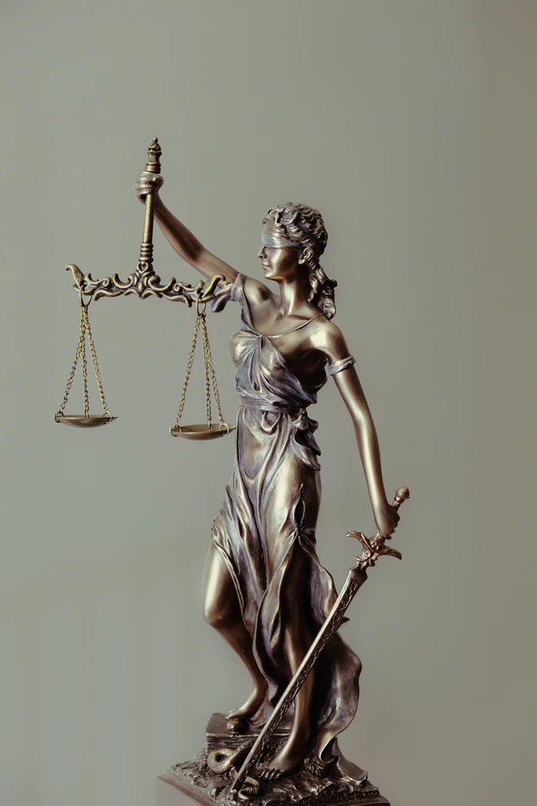
#3: Feedback
We are afraid of judgement
When we speak to or about ourselves we enforce our own judgement
We only self-reflect when things go wrong
Notes:
Image: https://images.unsplash.com/photo-1589578527966-fdac0f44566c?ixlib=rb-1.2.1&ixid=eyJhcHBfaWQiOjEyMDd9&auto=format&fit=crop&w=634&q=80

Slide 14
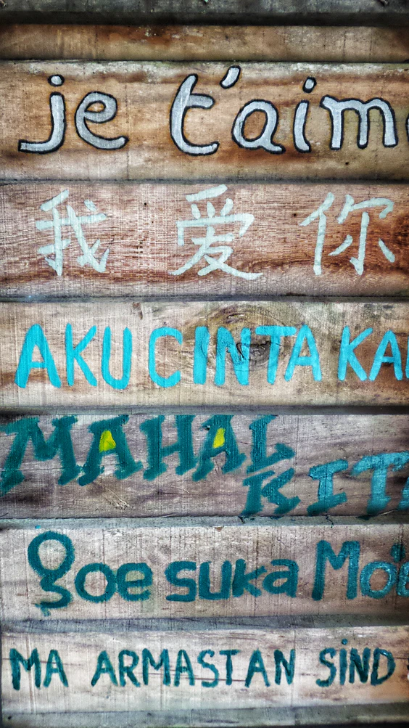
I’ll never be able to do this / I can’t do this
Change up your language.
I will be able to do this, who can I ask for help?
Notes:
Image: https://images.unsplash.com/photo-1571498664957-fde285d79857?ixlib=rb-1.2.1&ixid=eyJhcHBfaWQiOjEyMDd9&auto=format&fit=crop&w=564&q=80

Slide 15

Stop comparing yourself to others.
Everyone is different.
Notes:
Image: https://images.unsplash.com/photo-1571266882932-33f7c046a0c9?ixlib=rb-1.2.1&ixid=eyJhcHBfaWQiOjEyMDd9&auto=format&fit=crop&w=634&q=80

Slide 16

Resources
Brene Brown on Vulnerability (YouTube)
Stop Calling Yourself An Idiot (Blog)
Meditate in a Moment (YouTube)
Mindfulness Made Easy (Podcast)
Notes:
Image: https://images.unsplash.com/photo-1589578527966-fdac0f44566c?ixlib=rb-1.2.1&ixid=eyJhcHBfaWQiOjEyMDd9&auto=format&fit=crop&w=634&q=80

Slide 17

Notes:
Image: https://images.unsplash.com/photo-1502355984-b735cb2550ce?ixlib=rb-1.2.1&ixid=eyJhcHBfaWQiOjEyMDd9&auto=format&fit=crop&w=1350&q=80

